Slide 1
Sledge Meeting 10/22/2021

Slide 2
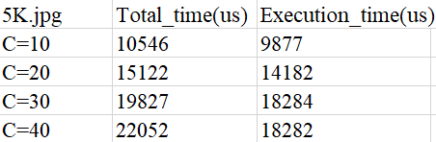
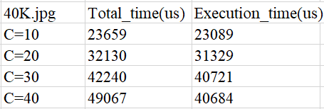
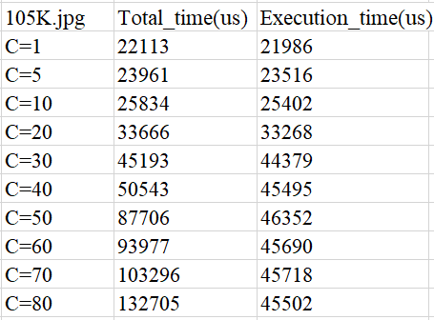
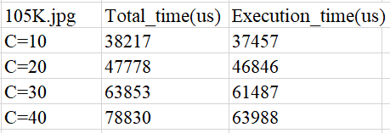
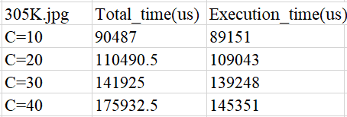
Single Request - Single Function (img Resize)
Single Request - Chain Function

Slide 3
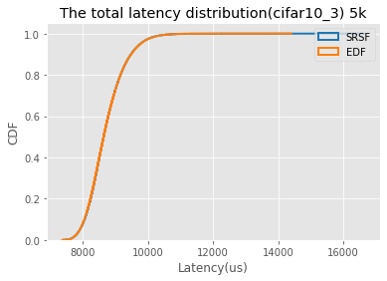
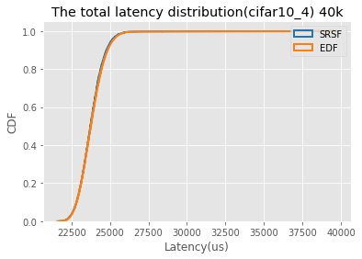
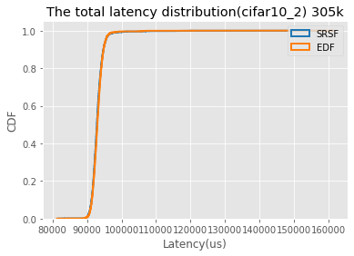
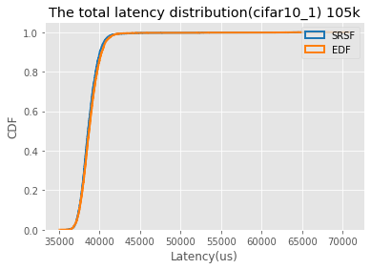
EDF vs SRSF(C=12)
SRSF:
5k request proportion: 59.00
40k requests proportion: 21.87
105k requests proportion: 13.48
305k requests proportion: 5.63
EDF:
5k request proportion : 59.04
40k requests proportion : 21.85
105k requests proportion : 13.46
305k requests proportion : 5.63
For the light workload, the requests distribution are the same, all requests meet their deadline
SRSF:
cifar10_3 :max latency is:16662 us
cifar10_4: max latency is:39746 us
cifar10_1 : max latency is:68361 us
cifar10_2 : max latency is:159235 us
EDF:
cifar10_3 max latency is:14436 us
cifar10_4 max latency is:39674 us
cifar10_1 max latency is:70873 us
cifar10_2 max latency is:161617 us

Slide 4
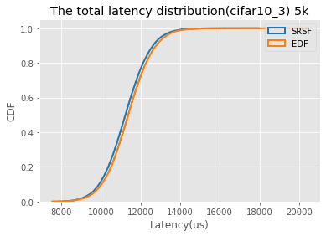
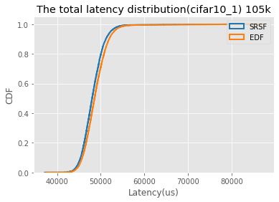
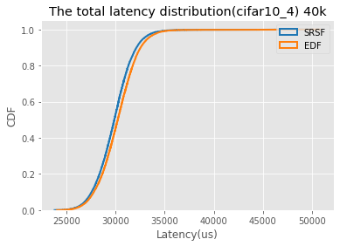
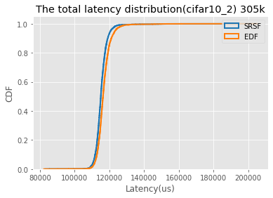
EDF vs SRSF(c=20)
For light workload, all requests meet their deadline, it seems SRSF has a shorter tail latency then EDF, but don’t know if this is randomness

Slide 5
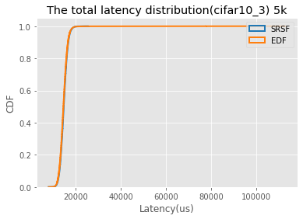
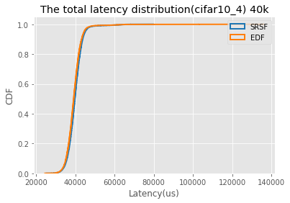
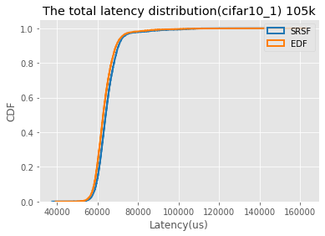
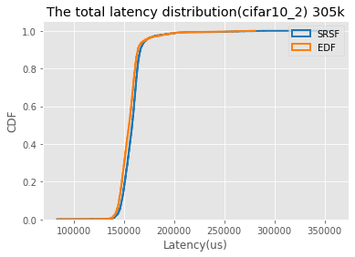
EDF vs SRSF(C=28)
For light workload, SRSF has a shorter tail latency then EDF with 5k, 40k and 105k requests, but longer tail latency than EDF with 305k requests, but don’t know if this is randomness.

Slide 6
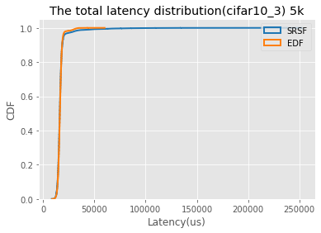
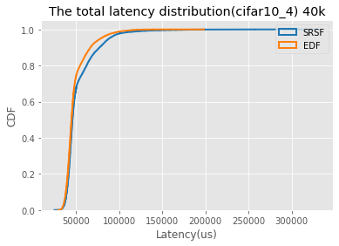


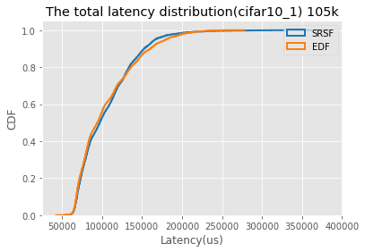
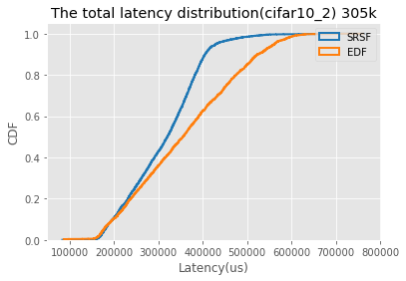
EDF vs SRSF(C=40)

Slide 7
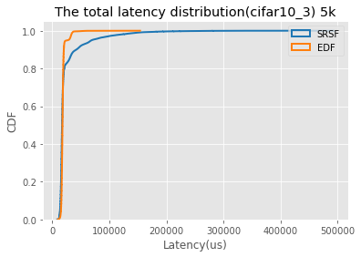
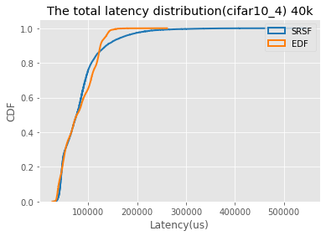


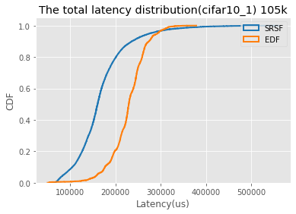
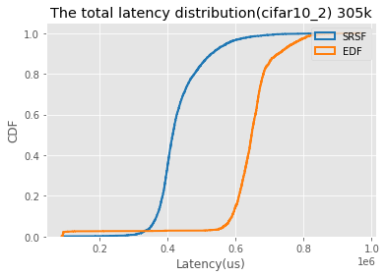
EDF vs SRSF(C=60)

Slide 8
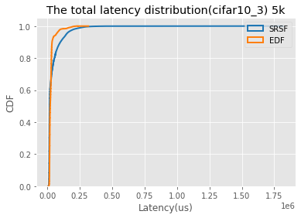
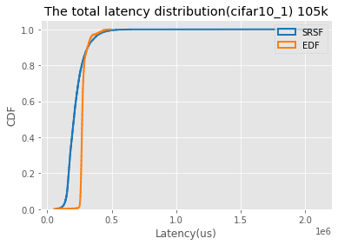


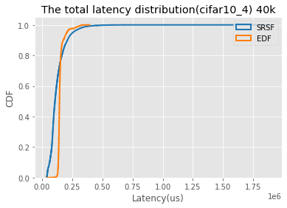
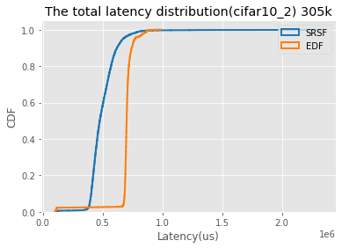
EDF vs SRSF(C=88)

Slide 9
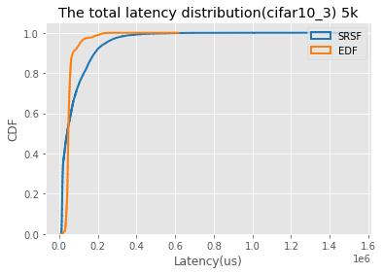
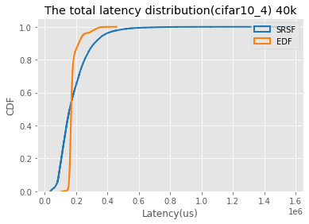

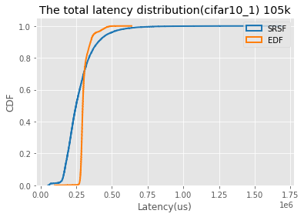
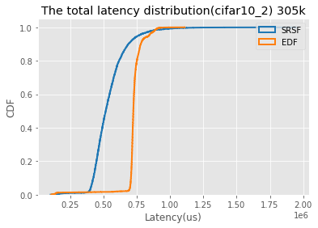

EDF vs SRSF(C=120)

Slide 10
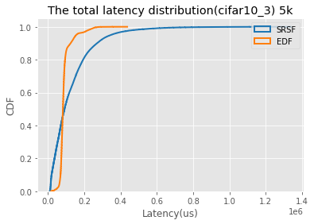
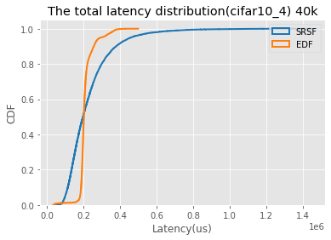



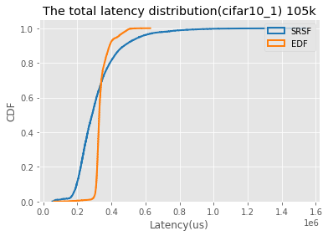
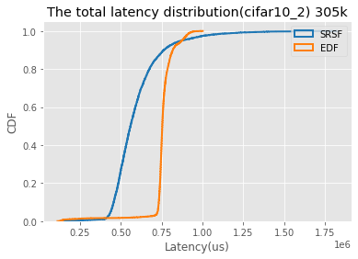

EDF vs SRSF(C=152)

